Slide 1
Top Level Review of ABM Allocation process
Eugene Rura, CPA – Based on Verizon CGT

Slide 2
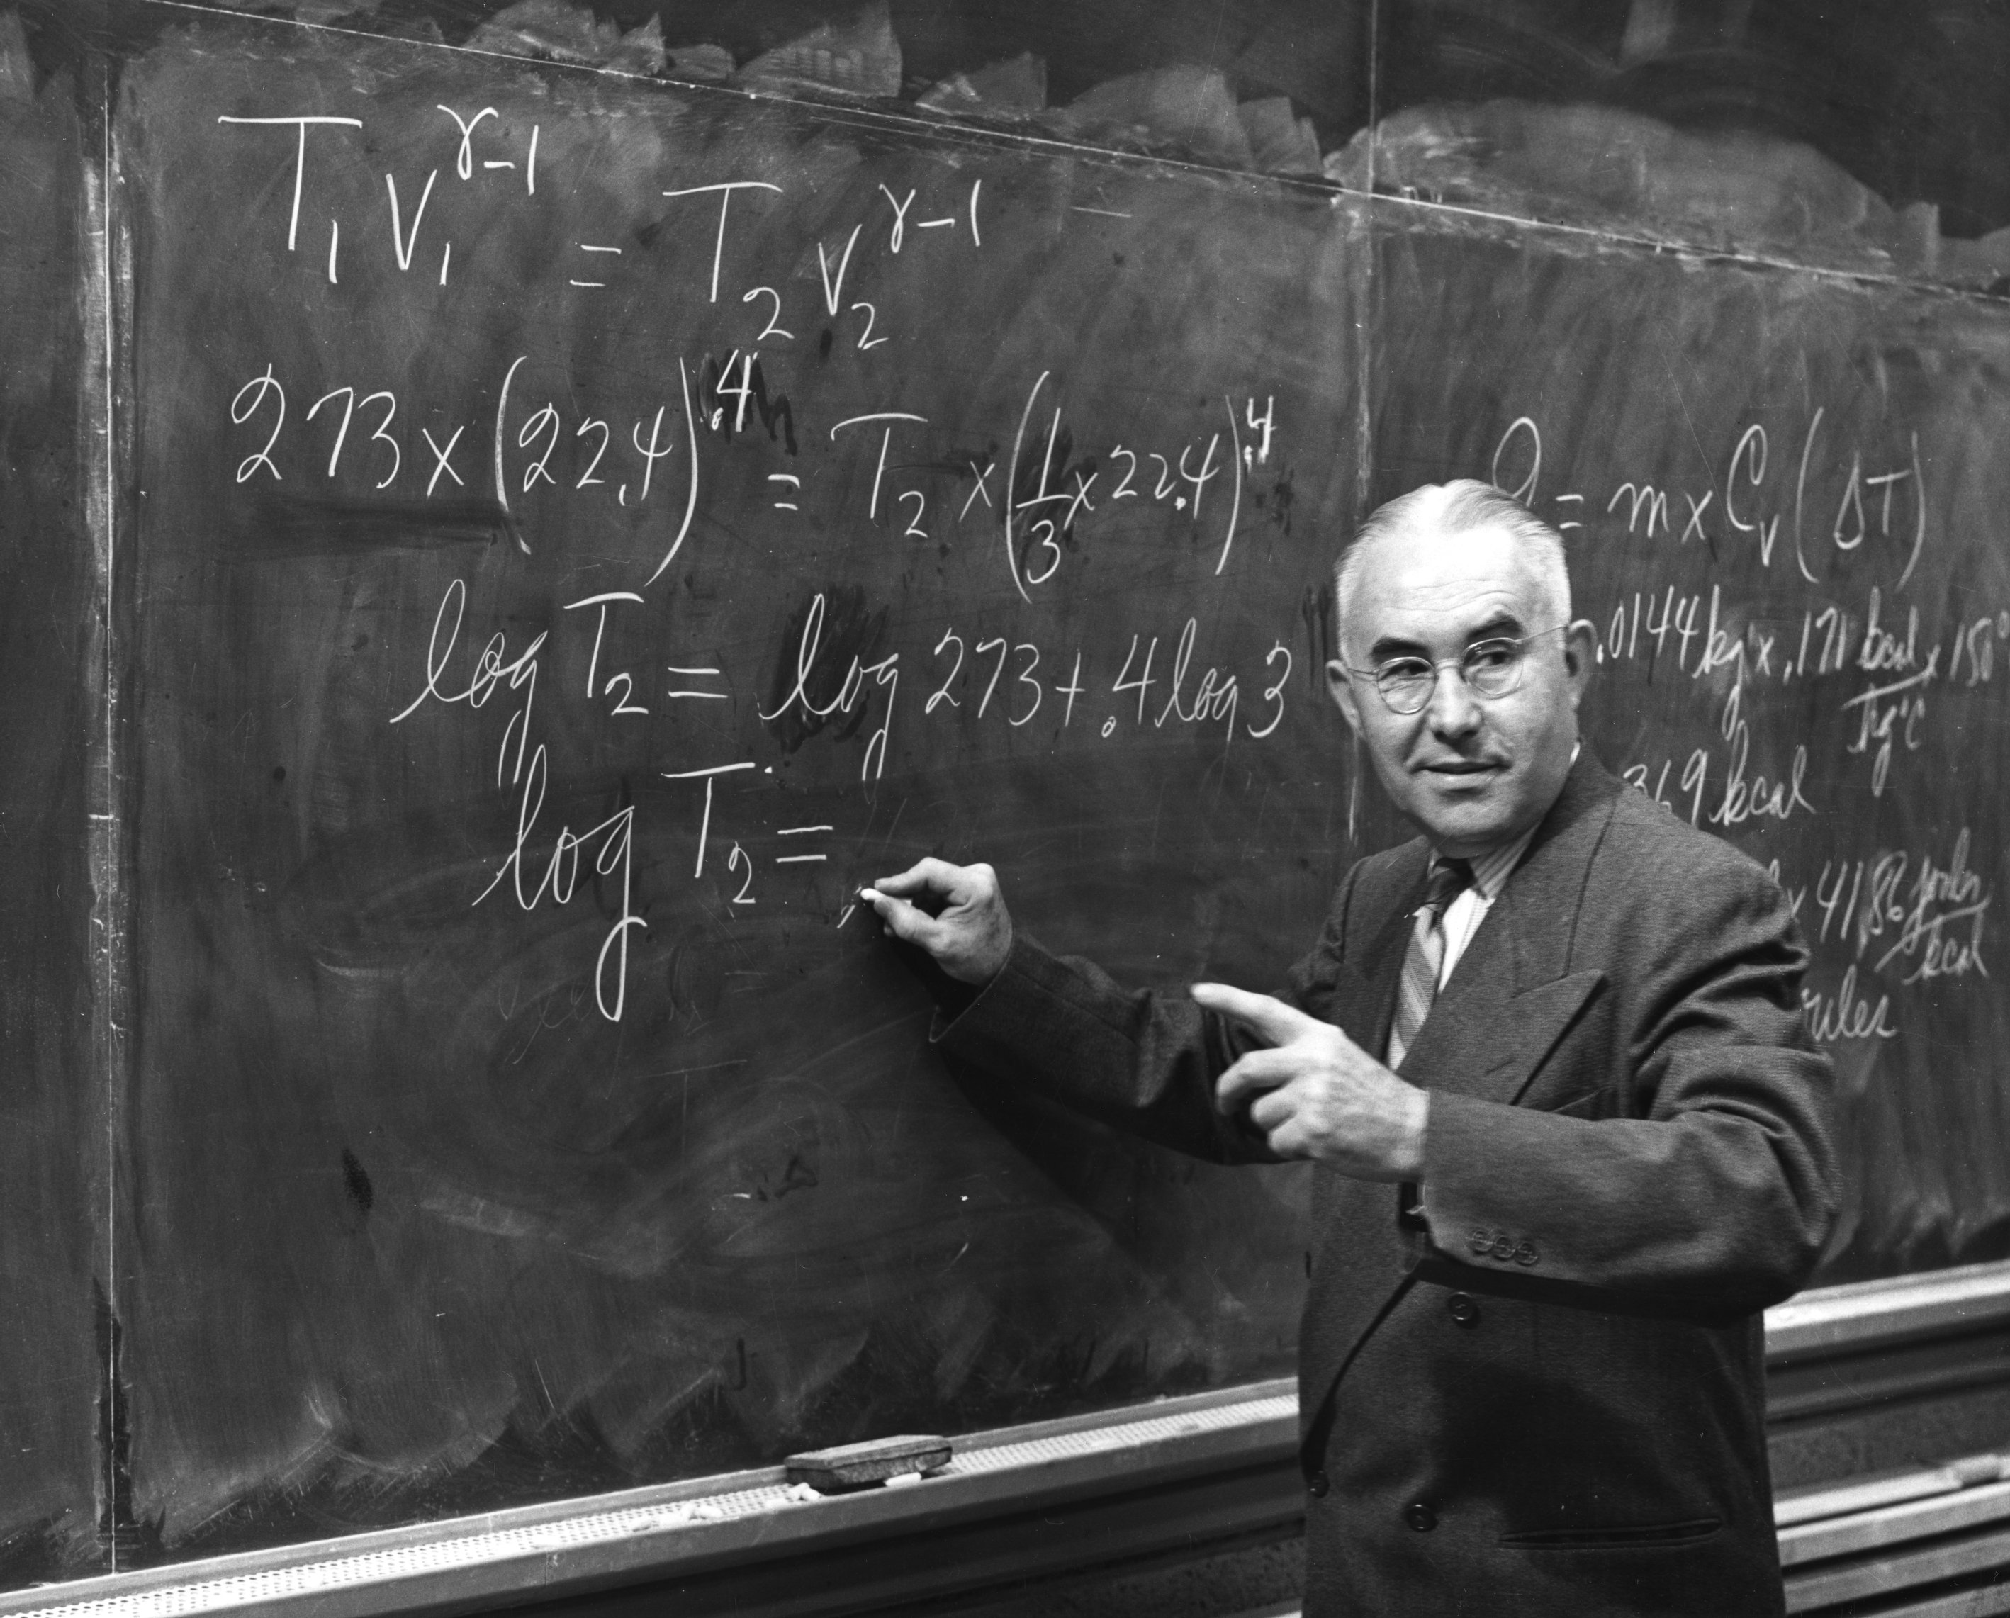
Introduction to the ABC Allocation Process at Cost Modeling Group
In this presentation I will concentrate on applicational issues of the ABC allocation. A good description of what ABC is in professional lingvo could be found in many sources, for example here. Activity Based Costing is in its essence creation of a matrix of multivariate allocation factors (that could logically be illustrated by asking a question – “how much of a lazy financial analyst’s salary should be recovered by product A?”) based on witchcraft and wizardry of a mixture of common sense and available activities records; once the costing pools are complete, the next step is deciding the allocation matrices – how should that allocation be spread - what factors should be considered?
In this presentation I would like to briefly outline the process flow using an oversimplified example, and then walk back pointing data silos that CGT group has built for this process, and finally look at the coding that goes into support of this function.
This is Prof. R. Snyder of NCSU, and I stole his picture to illustrate that the whole thing will be boring and full of numbers and technical jargon. And at the bottom is a picture of a chopped-up penny to illustrate that what we are trying to do at the end is to split the costs and allocate it to something at the end of the chain.

