Slide 1
Cost Modeling Group Business Intelligence Data Warehouse
An instance of implementation of MS SQL Server technology in financial analysis environment

Slide 2

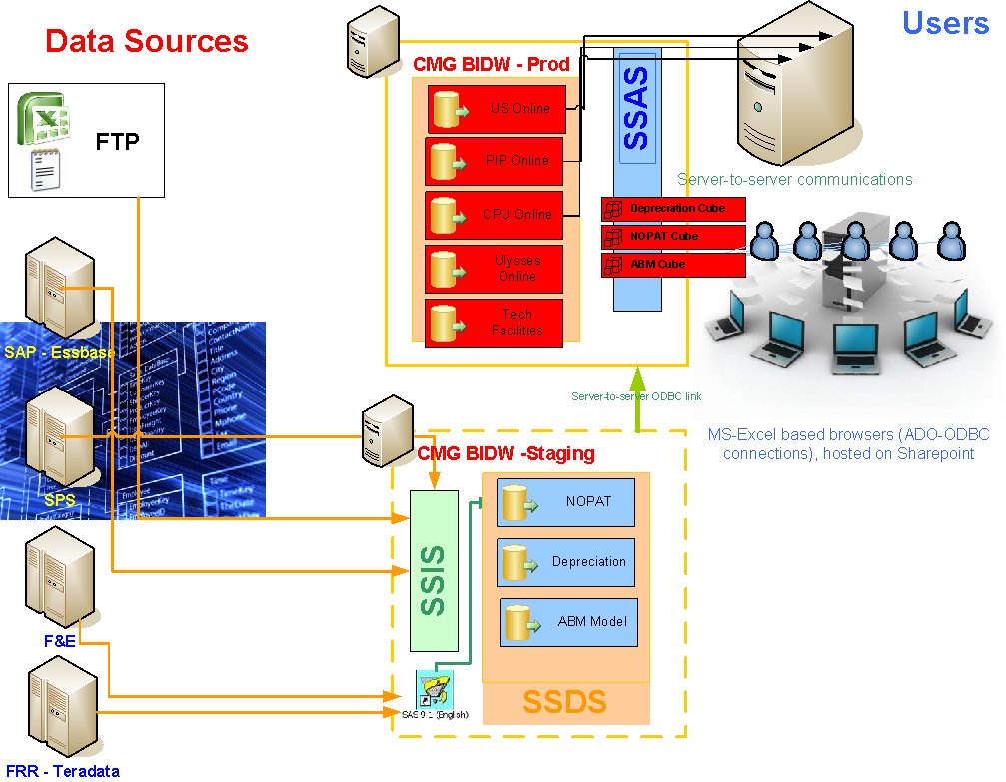
Platform:
2 Midrange Virtual farm servers (Windows03/08), user management via AD,
MS SQL Servers (05 and 08), SSIS, SSAS, MS Visual Studio - Business Intelligence. Connectivity with other systems provided via ODBC connections via Teradata/SAS environment
Platform Layout

Slide 3
6 product models (T-SQL procedure/function based) returning data to E2Ei (end-2-end integration - a joint backbone system integrating crcuit-provisioning chain with sales-support and user-support chains) via SSIS and individual cost models via Excel-Pivot table/ODBC Native SQL queries interacted with via VBA;
Function 1: Data Exchange Mechanism between E2Ei and individual Cost Models
Request from sales
Defining Product
Defining Feature
Defining Specifications
Compilation of the Quote
Cost Modeling inputs
PCM Inputs
Result
Quote
E2Ei
Reroute request to db
Match request w/ costs
Receive Batch Request
CMG
Telco Costs
COSP Allocation
Depreciation
Telco Costs
COSP Allocation
Depreciation
Cost Models

Slide 4

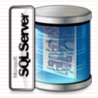


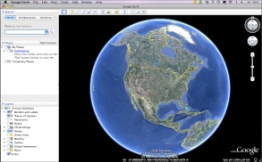


Cross-platform data consolidation (Oracle/Teradata/SQL via SAS 9.2 and SSIS) for BI OLAP models (PIP PROMAT)
Function 2: PIP PROMAT
Comprised of 5 main elements:
  PIP Cost Model
  NOPAT OLAP Cube
  Cost Trends OLAP Cube
  Detailed Monthly Snapshots database
  Google Earth .KML PE Node map
CMG
Monthly Pull of all active PIP ccts from Engineering
Add pulls from VDDS system
Match with Revenue and Customer Data from Billing systems
SQL Data Warehouse

Slide 5
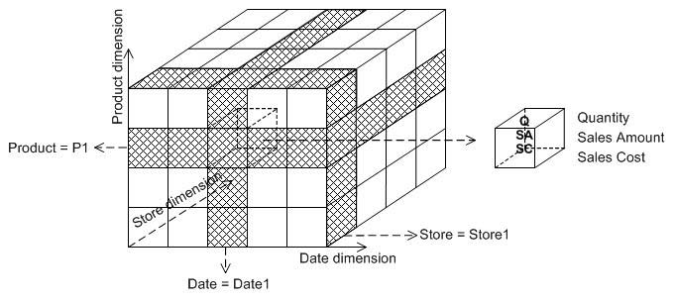
Function 2: PIP PROMAT – Contd.
Why do we need NOPAT for cost modeling purposes
  Four Way Match (Revenue/Unit/Cost/Factors)
  Multidimensional view of data properties
  Audit capability/Tie to reality
  Improvement in forecasting abilities
PIP Promat – MSAS OLAP Cube based on the multiple systems consolidation data . MS Excel spreadsheet accessed via Sharepoint environment though Pivot Tables.

Slide 6
Function 3: COSP-SGA allocation to products via ABM/ABC
Conceptual framework:
ABM Group develops factors
  ABC is used to trace operational and shared expenses to cost objects using cost drivers
  ABC provides insights to cost for business process and operation management (Activity Based Management)
  SAS Activity-Based Management is a software tool designed to model an organization’s structure and analyze the flow of cost through that structure
  Model is flexible to reflect operational changes or integrate new measures
Resources
Activities
Products &
Services
Drivers
Activities
Processes

Slide 7


Function 3: COSP-SGA allocation to products via ABM/ABC – Contd.
Factors by Hierarchies
PnL Code
Org. Unit
Derived Hierarchies
Group Allocations
Products
Application Values
22 M tuples of allocation factors
Etc…
Via Hyperion Essbase
Financials
Current data by Cost Center and PnL Item
Factors provided by ABM Group
Allocate cost to products
Prepare multidimensional factors match
Grouping algorithms
CMG
Distribution to users via Excel Pivot Tables
OLAP MSAS Cube

